Slide 1
A Deep Learning Approach For Detection of Alzheimer’s Disease

Slide 2
TEAM MEMBERS
S.NO | ROLL NO | STUDENT NAME
1 | 160719733023 | MANJREKAR DHRUV TEJA
2 | 160719733003 | TAUSEEF ALI KHAN
3 | 160719733002 | SANTOSH BHONAGIRI
Project Coordinator
Mr. T. Praveen Kumar
Under the Guidance of
Mr. A R R Senthil Kumar
Associate Professor

Slide 3
Table of Content
Introduction
Literature Survey
Motivation For Project
Gap Analysis
Objectives
Problem Statement
System Architecture
Data Flow Diagrams
Algorithm
System Implementation
User Interface
Conclusion
Future Scope
Bibliography

Slide 4
1. INTRODUCTION

Slide 5
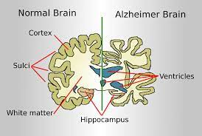
Alzheimer’s Disease
Alzheimer's disease is a progressive neurologic disorder that causes the brain to shrink (atrophy) and brain cells to die. Alzheimer's disease is the most common cause of dementia. Alzheimer’s causes problems with memory, thinking and behavior.

Slide 6
Risk Factors For Alzheimer’s
Age
Family Members with Alzheimer’s / Genetics
Mild Cognitive Impairment (MCI)
Cardiovascular Disease
Education and Alzheimer’s
Traumatic Brain Injury

Slide 7
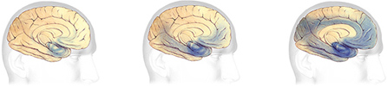
Earliest Alzheimer's
Mild to moderate Alzheimer's stages
Severe Alzheimer's

Slide 8
2. LITERATURE SURVEY

Slide 9
Authors | Title | Methodology | Dataset | Scope | Evaluation Parameters
C.Kavitha, Vinodini Mani, S.R Sri Vidhya, Osmah Ibrahim, Carlos Andres | Early-Stage Alzheimer's Disease Prediction Using Machine Learning Models | The Alzheimer disease predictions using various machine learning algorithms to effectively distinguish the affected individuals with high degree of efficiency and speed. | OASIS Dataset, Kaggle Dataset | The future work will focus on the extraction and analysis of new features that will be more likely to aid in the detection of Alzheimer's Disease. | Accuracy Precision Recall F1 score confusion matrix

Slide 10
Authors | Title | Methodology | Dataset | Scope | Evaluation Parameters
Dan Pan, An Zeng, Longfei Jia,Yin Huang,Tory Frizzell and Xiaowei Song | Early Detection of Alzheimer’s Disease Using Magnetic Resonance Imaging. | In order to achieve two objectives with a deep learning approach, CNN and EL were combined and applied to most commonly acquired anatomical brain MRIs: classification of AD and MCIc vs. HC, and MCIc vs. MCInc and identification of AD-related complex change patterns. | ADNI Dataset | It is also possible to detecting other brain diseases such as Parkinson’s disease, autism, schizophrenia and severe depression, other little-known brain disorders. | Accuracy Standard deviation

Slide 11
Authors | Title | Methodology | Dataset | Scope | Evaluation Parameters
Vasco Sá Diogo, Hugo Alexandre Ferreira & Diana Prata | Early diagnosis of Alzheimer’s disease using machine learning: a multi-diagnostic, generalizable approach | A study performed on structural changes in the brain for early detection of AD. The proposed method for multi-diagnostic classification of HC, MCI, and AD is an ensemble of 3 binary classifiers using L-SVM, RF, EF, LDA, LR, LR-SGD, MCC, CV, SD methods and techniques. | ADNI: MPRAGE Dataset OASIS Dataset IR-SPGR Dataset | The classifiers did not make use of cognitive features or scores, which could be of high predictive value and can be easily acquired. | Matthew’s correlation coefficient(MCC), Area under the receiver operating characteristic curve(AUC), Balanced accuracy(BAC), ROI

Slide 12
Authors | Title | Methodology | Dataset | Scope | Evaluation Parameters
Carol Y cheung, An Ran Ran, Shujun Wang, Victor TT Chan, Kaiser Sham, Saima hilal | A deep learning model for detection of Alzheimer's disease based on retinal photographs: retrospective, multicentre case-control study | A retinal photograph-based deep learning algorithm using unsupervised domain adaptation is used to detect Alzheimer's disease in individuals.Deep learning algorithms proved consistently accurate at distinguishing between Alzheimer's disease-dementia and unaffected individuals. | Private Dataset | Alzheimer's disease research might explore any increments in sensitivity and specificity when combining retinal photography with blood-based biomarkers, such as brain amyloid. | Accuracy, Sensitivity, Specificity, AUROC

Slide 13
Authors | Title | Methodology | Dataset | Scope | Evaluation Parameters
Weiming lin, Tong Tong, Qinquan Gao, Di Guo, Xiaofeng Du, Yonngui Yang, Gang Guo, Min Xiao, Min Du, Xiaobo Qu | Convolutional Neural Networks-Based MRI Image Analysis for the Alzheimer's Disease Prediction From Mild Cognitive Impairment | A framework developed using MRI images to predict MCI-to-AD by applying CNN and other machine learning algorithm. The FreeSurfer was used to mine more morphological information of MRI images, such as cortical volume, surface area, cortical thickness average, and standard deviation of thickness in each region of interest. | ADNI Dataset | The period of predicting conversion was set to 3 years, which separates MCI subjects from those who do not convert to AD. Our future work would investigate the usage of CNN in modelling the progression of AD. | Accuracy. Standard deviation. Confidential interval.

Slide 14
3. MOTIVATION FOR PROJECT

Slide 15
1. Alzheimer's disease was described in 1906. It has taken a century for scientists to understand how Alzheimer's affects the brain and to learn how to improve the quality of life for sufferers.
2. It is a deadly disease and no permanent cure is invented.
3. Most symptoms are common so it is hard to identify.
4. Numerous Risk Factors.

Slide 16
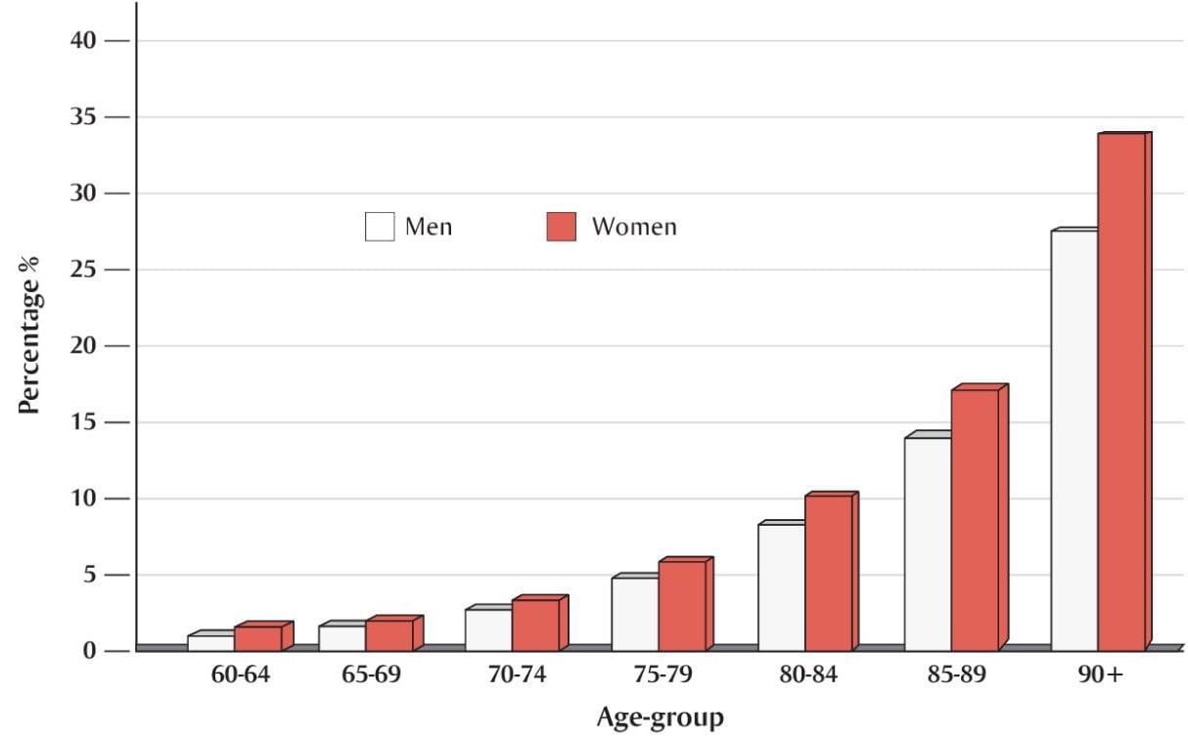
Dementia in men and women with age progression

Slide 17
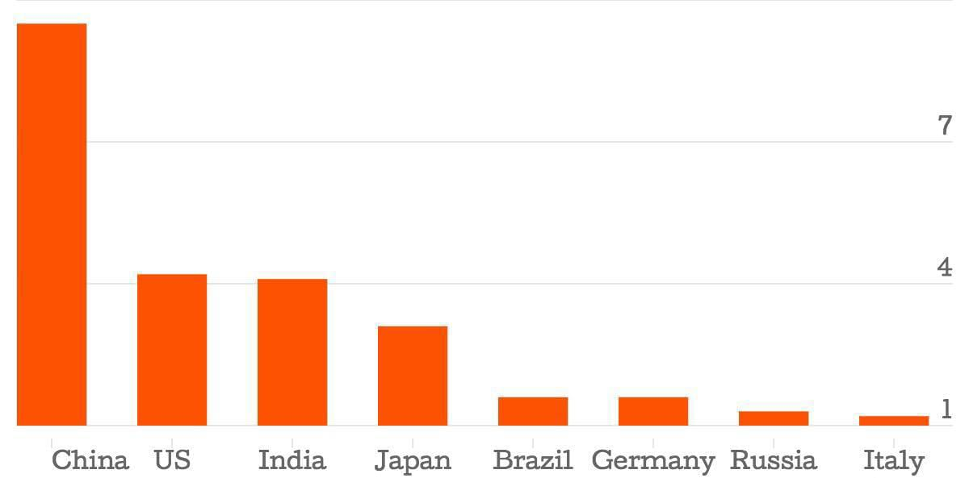
Country-wise prevalence of Dementia (>1 million)

Slide 18
4. GAP ANALYSIS

Slide 19
Proposed research focuses on binary detection rather than Categorical classification.
The focus is on Alzheimer's disease detection in individuals over 60+ age, whereas early detection can lead to better treatment outcomes.
In most datasets, genetic based Alzheimer disease accounts for between 40-50%, whereas unbiased data is more accurate.

Slide 20
5. OBJECTIVES

Slide 21
Improve the early diagnosis of Alzheimer disease, and make it less time consuming that gives a better chance of treatment.
Developing intervention to delay or prevent the one set of Alzheimer disease.
Usage of various deep learning algorithms instead of only using traditional ML methods.
Robust and Accurate classification can be achieved.

Slide 22
6. PROBLEM STATEMENT

Slide 23
A Deep Learning method for Early detection of Alzheimer’s disease using Deep Convolutional Neural Networks models using Transfer learning Methodology.

Slide 24
7. SYSTEM ARCHITECTURE

Slide 25
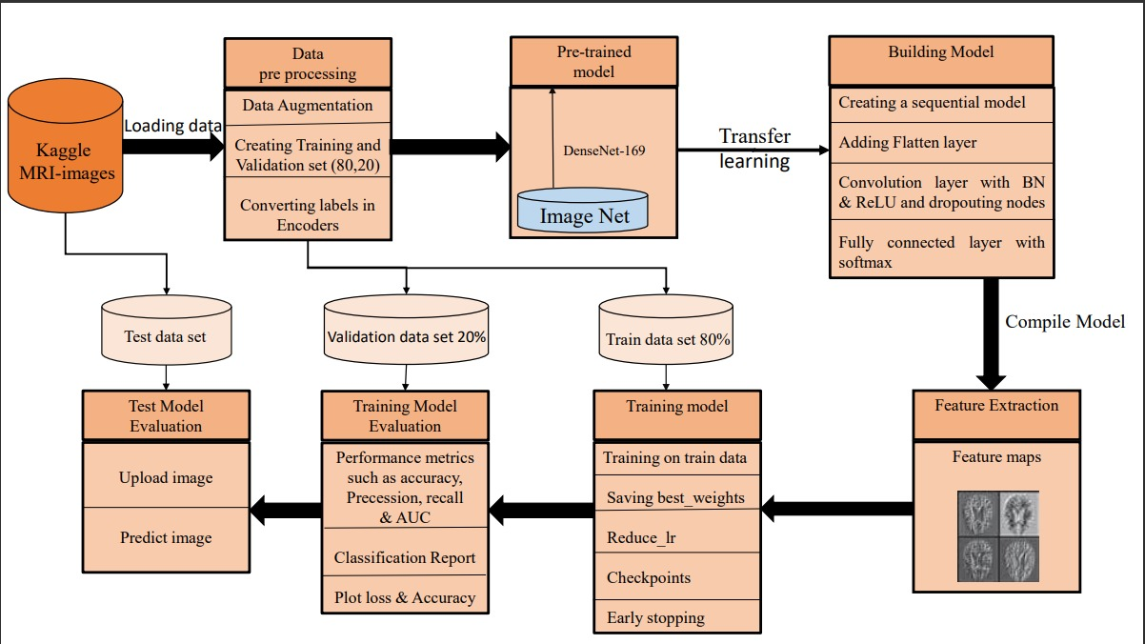

Slide 26
System Architecture Components
Data collection
Data pre-processing
Pre-trained model
Feature extraction
Building model
Training model
Train model evaluation
Test model evaluation

Slide 27
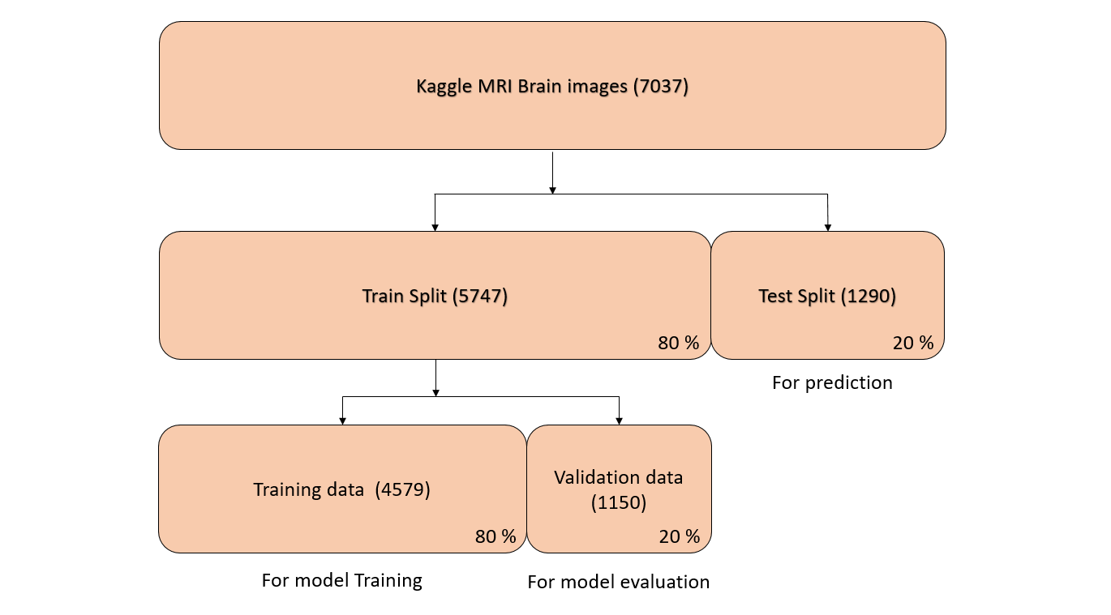
Data Collection

Slide 28
Data Pre-processing
Loading train split data.
Image to array conversion and randomizing data.
Creation of Training and validation datasets (80:20).
Conversion of labels into encoders.

Slide 29
Pre-Trained Model
DenseNet-169 is one of the architectures of the DenseNet family with 169 layers and is a widely used architecture for DL classification tasks.
DenseNet-169 architecture have the ability to overcome the vanishing gradient problem.
DenseNet models can be found in Tensorflow (Keras) and PyTorandes.

Slide 30
Building Model
Creation of sequential model to specify the network.
Dropouting of neural nodes to prevent overfitting.
Batch normalisation of deep neural networks (DNN) .
Activation layer with ReLU to detect features.
Fully connected layer with softmax activation function to normalise the output.

Slide 31
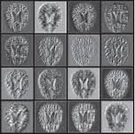
Feature Extraction
The feature map generation at each convolutional layer using feature detector called Kernel.

Slide 32
Training Model
Training on train dataset.
Saving the best weights from different weights obtained.
Reduce the value of learning rate if required.
Implementation of checkpoints to save weights and reduce memory usage.
Early stopping, when the performance stops improving.

Slide 33
Model Evaluation
Using Performance metrics such as Accuracy, Precision, Recall etc.
Plot Loss and Accuracy values of training and validation data are evaluated.

Slide 34
Test Model Evaluation
Upload test image.
Predicting stage of alzheimer’s with accuracy of classification.

Slide 35
8. DATA FLOW DIAGRAMS

Slide 36
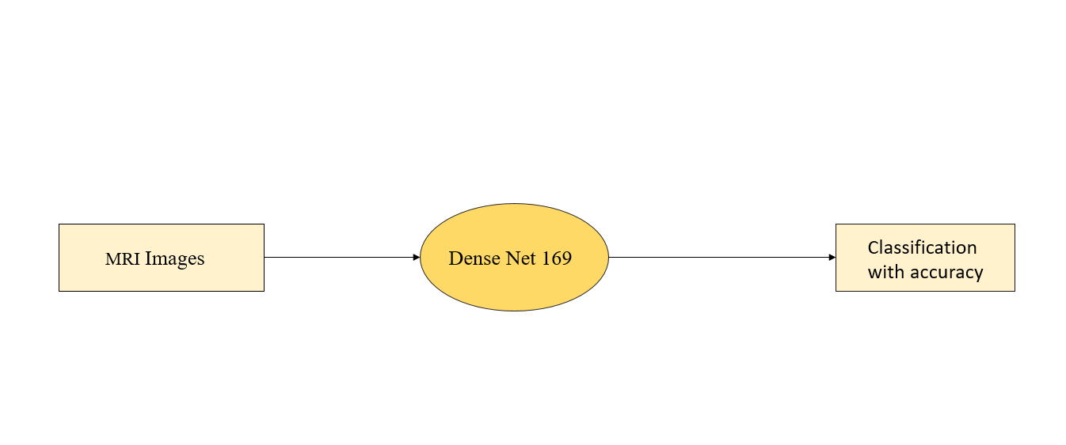
DATA FLOW DIAGRAM LEVEL 0

Slide 37
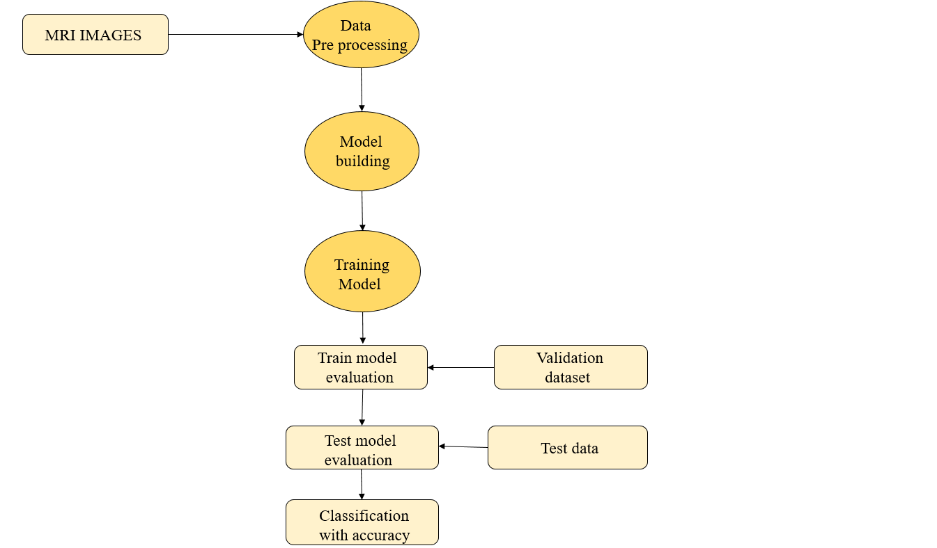
DATA FLOW DIAGRAM LEVEL 1

Slide 38
9. ALGORITHM

Slide 39
Input: MRI images of the Brain.
Output: Achieving accuracy with Alzheimer's disease stage.

Slide 40
Step 1: Data collection
1.1: MRI images of Brain collected from kaggle.
1.2: Data containing four stages of Alzheimer’s.

Slide 41
Step 2: Data pre-processing
2.1: Self Augmenting data.
2.2: Defining labels for loading data.
2.3: Loading data.
2.3.1: Appending images in X_train.
2.3.2: Appending corresponding labels on Y_train.
2.4: Shuffling X_train, Y_train data.
2.5: Dividing X_train, Y_train into training and validation dataset.
2.6: Converting labels into encoders.

Slide 42
Step 3: Model Creation
3.1: Using Densenet169 Model.
3.2: Adding Layers and function.
3.2.1: Flatten layer.
3.2.2: Batch normalisation.
3.2.3: Dense layer.
3.2.4: ReLU activation.
3.2.5: Dropout nodes.
3.2.6: Softmax activation function.
3.3: Compilation of model.
3.3.1: Defining metrics.
3.3.2: Compiling model using adam optimiser.
3.4: Feature maps.

Slide 43
Step 4: Model Training and Testing
4.1: Training model.
4.1.1: Define Call Backs.
4.1.1.1: Early stopping.
4.1.1.2: Checkpoint.
4.1.1.3: learning_rate.
4.1.2: Training on train dataset.
4.2: Plotting history.
4.2.1: Summarize history for loss.
4.2.2: Summarize history for accuracy.
4.3: Evaluate model.
4.3.1: Evaluate model on train data.
4.3.2: Evaluate model on validation data.

Slide 44
Step 5: Execution of Model
5.1: Model providing Lose of ______ .
5.2: Model providing Accuracy of ______ .
5.3: Model providing Precision of ______ .
5.4: Model providing Recall of ______ .
5.5: Model providing F1-Score of _____ .
5.6: Model providing AUC of ______ .

Slide 45
Step 6: Model testing on random data
6.1: Execution of image prediction function.
6.1.1: Upload image.
6.1.2: Predict image.
6.2: Get result with accuracy and state of disease.

Slide 46
10. SYSTEM IMPLEMENTATION

Slide 47
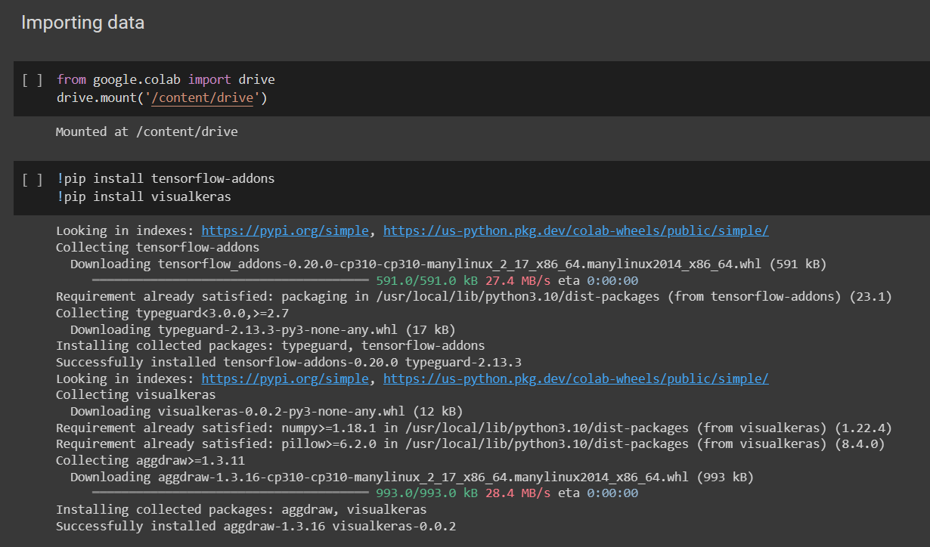

Slide 48
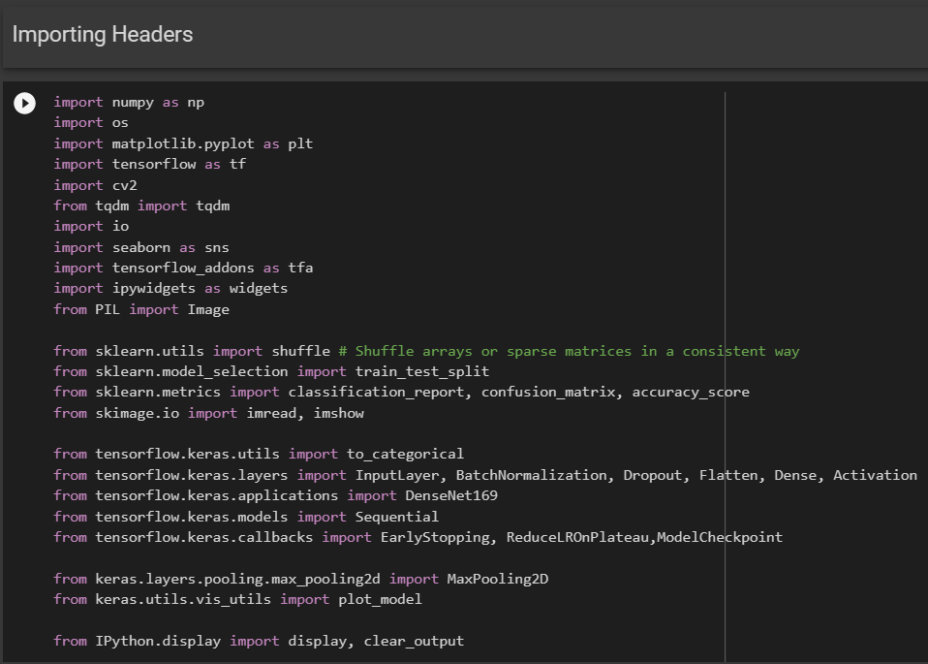

Slide 49
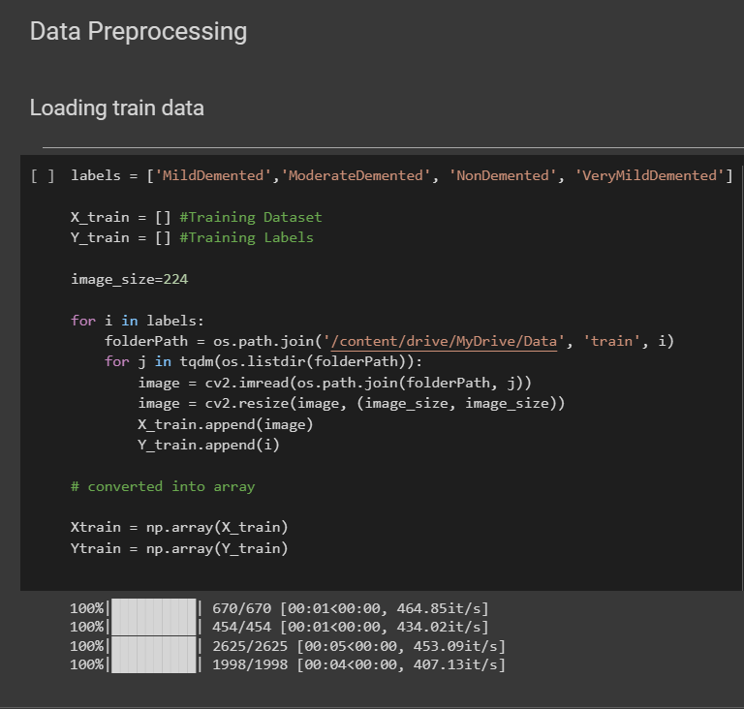

Slide 50
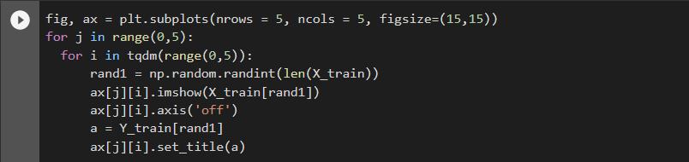
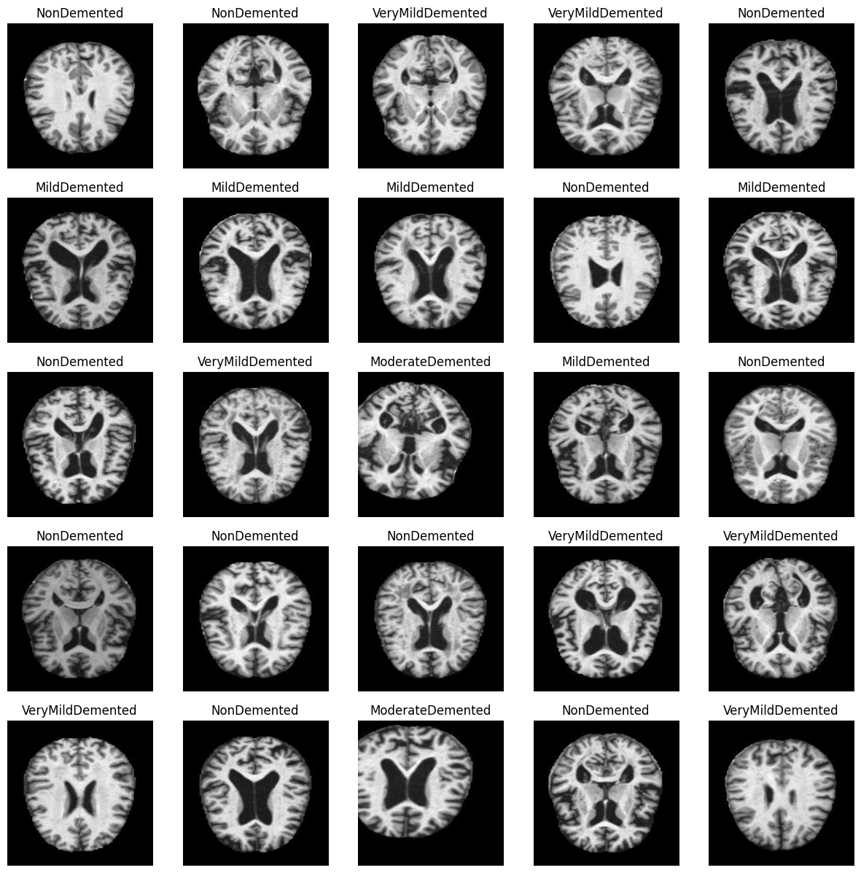

Slide 51
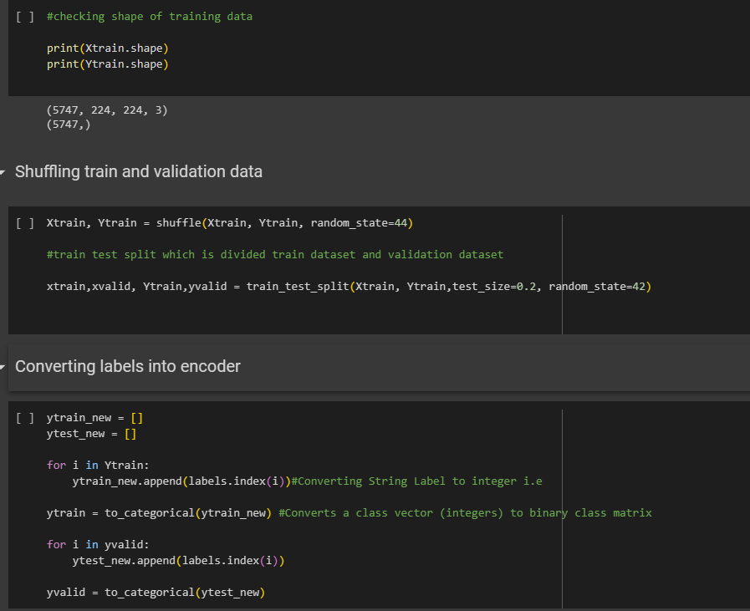

Slide 52
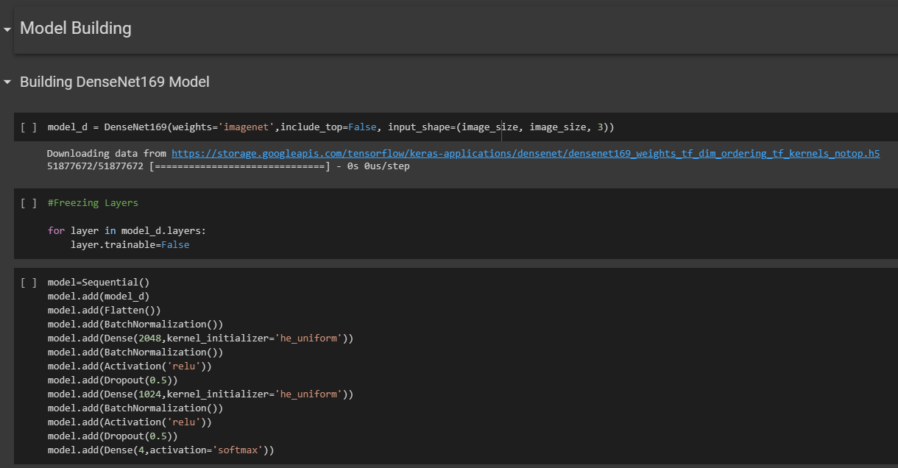

Slide 53
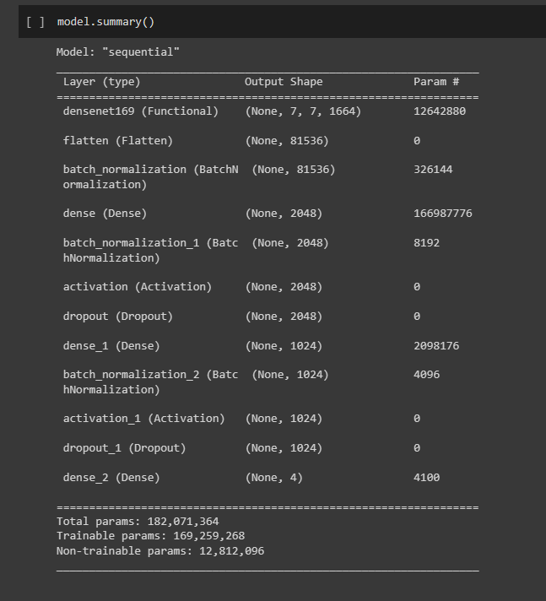

Slide 54
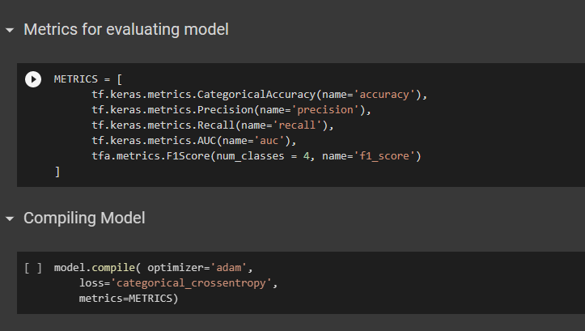

Slide 55
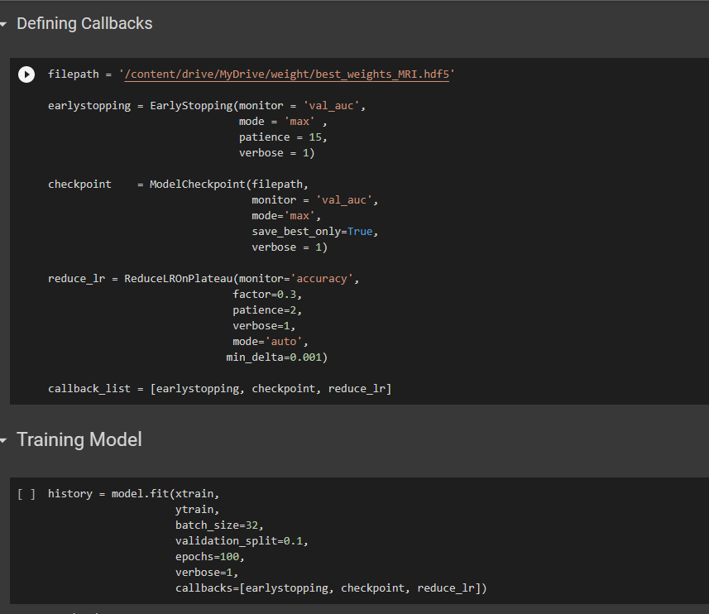

Slide 56
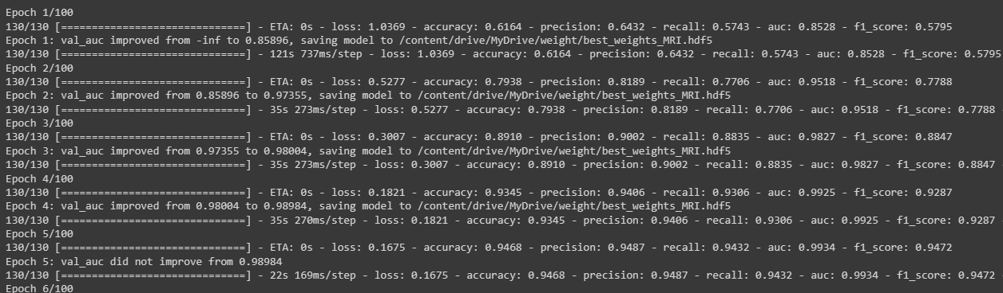
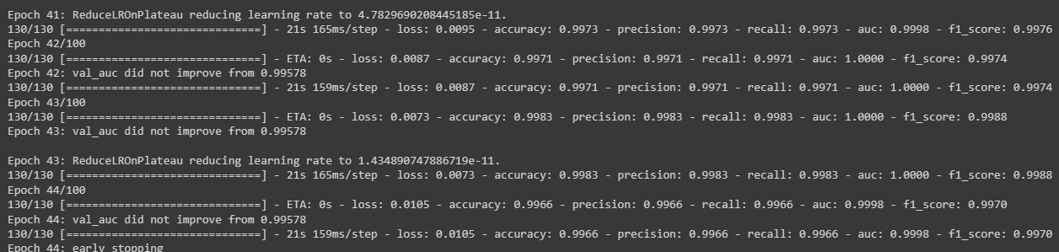

Slide 57
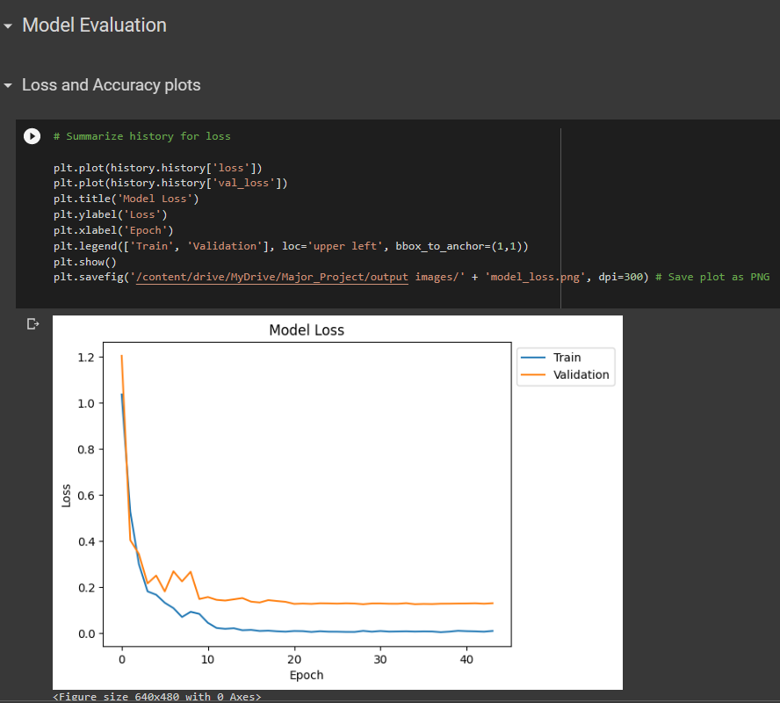

Slide 58
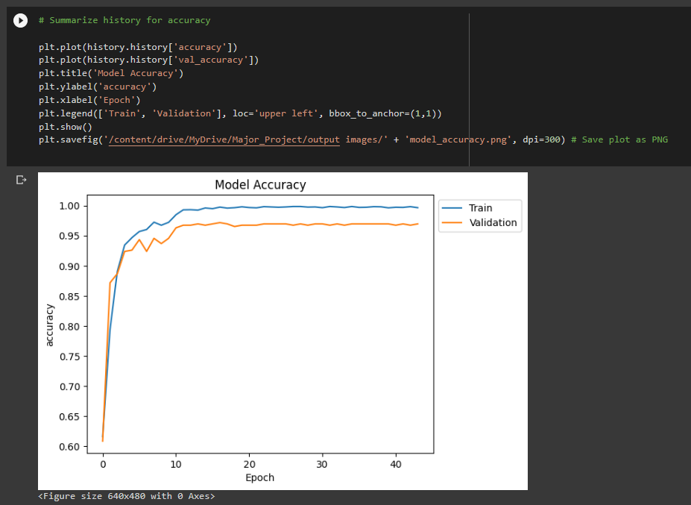

Slide 59
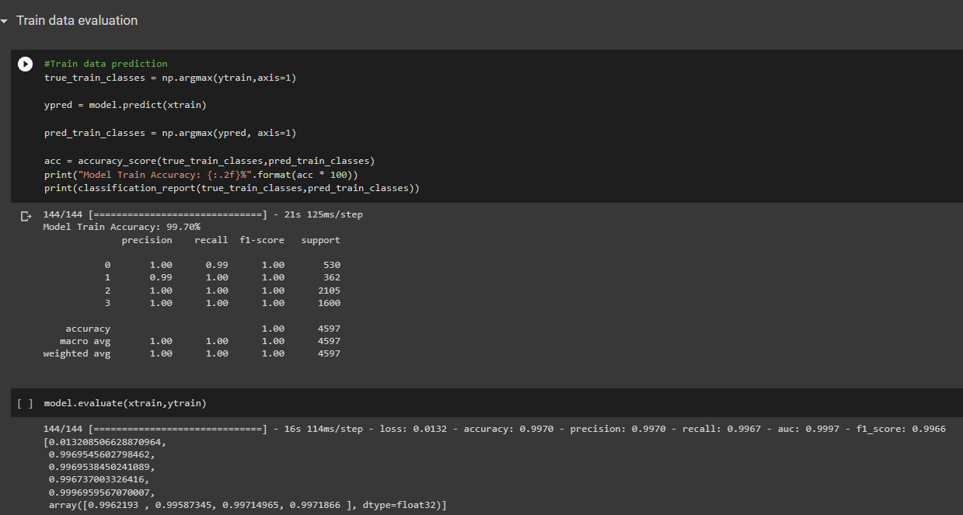

Slide 60
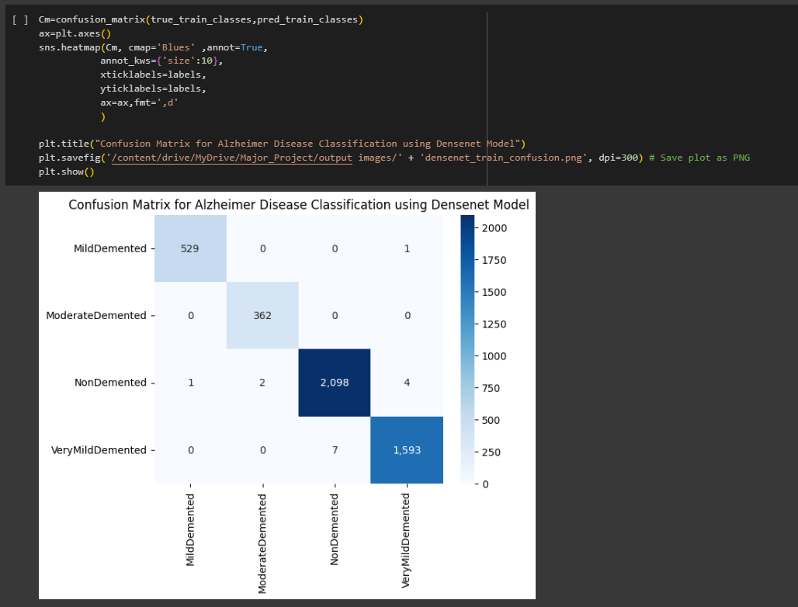

Slide 61
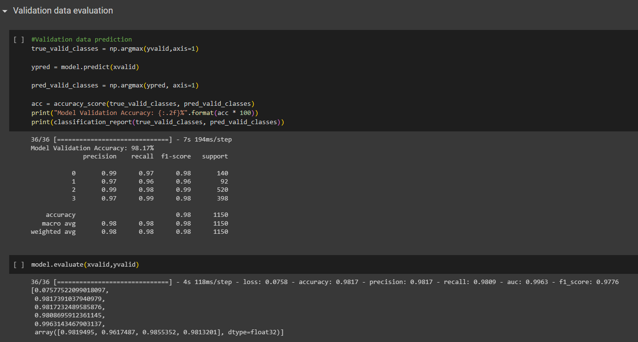

Slide 62
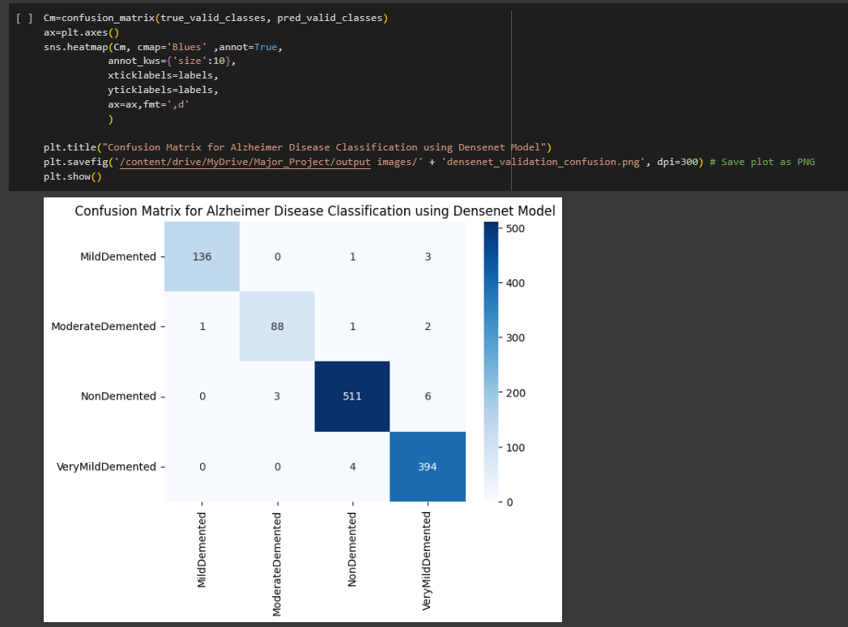

Slide 63
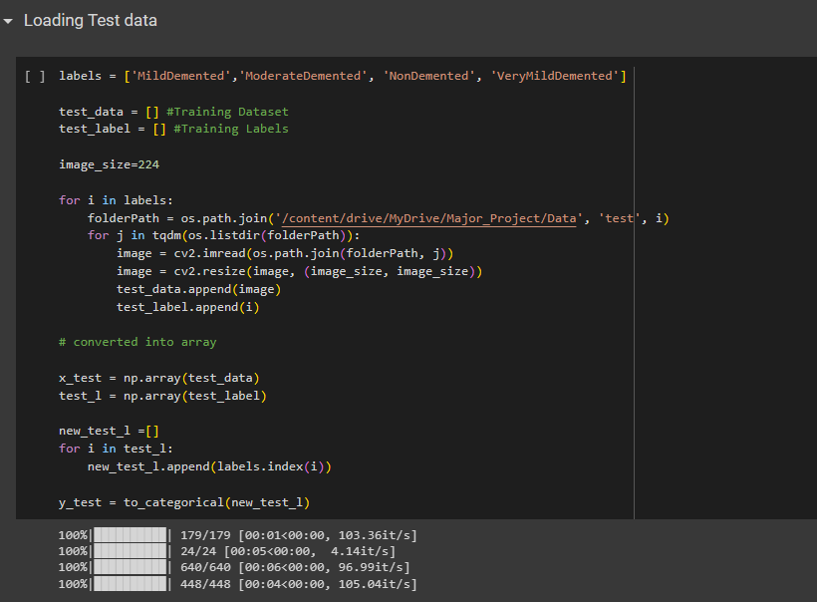

Slide 64
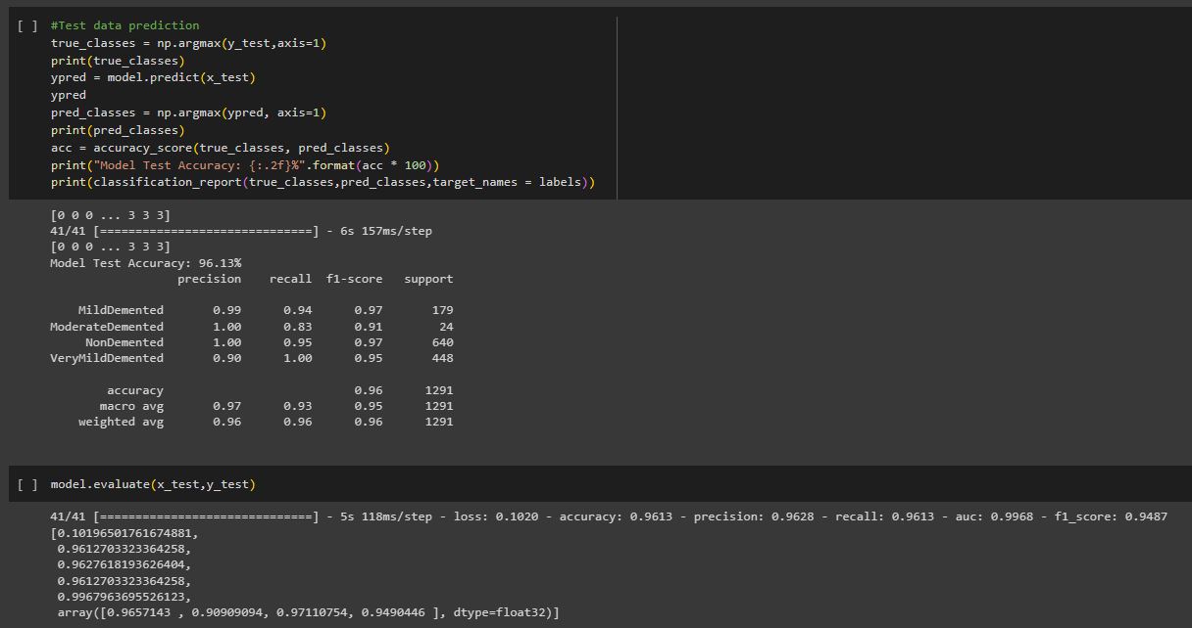

Slide 65
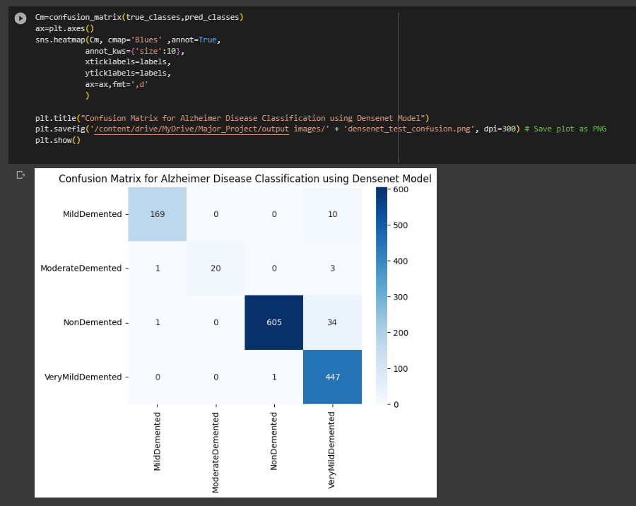

Slide 66
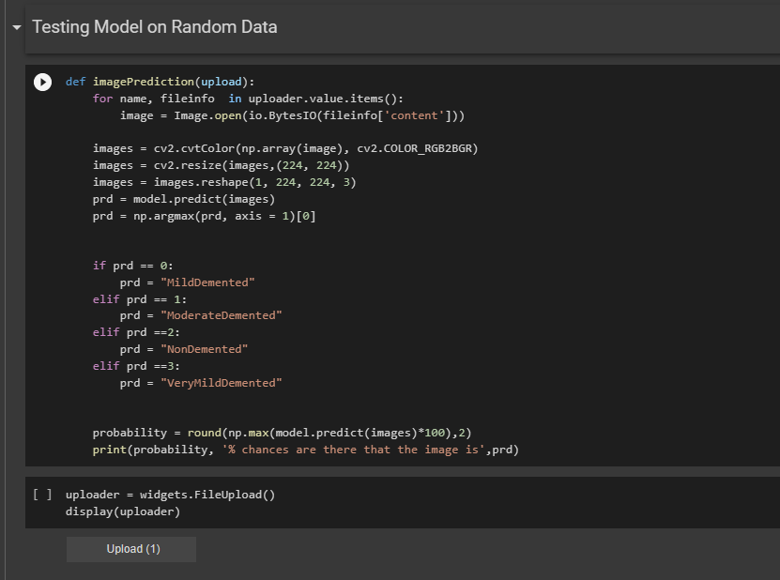

Slide 67
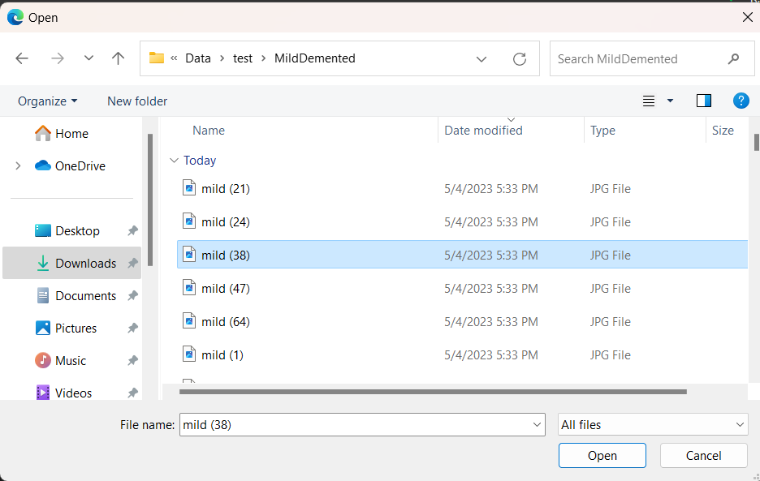

Slide 68
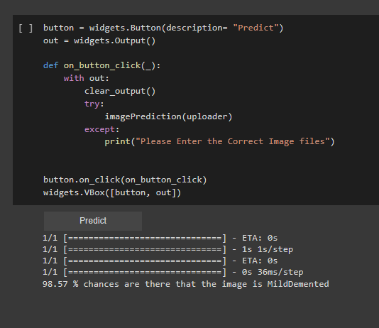

Slide 69
11. USER INTERFACE

Slide 70
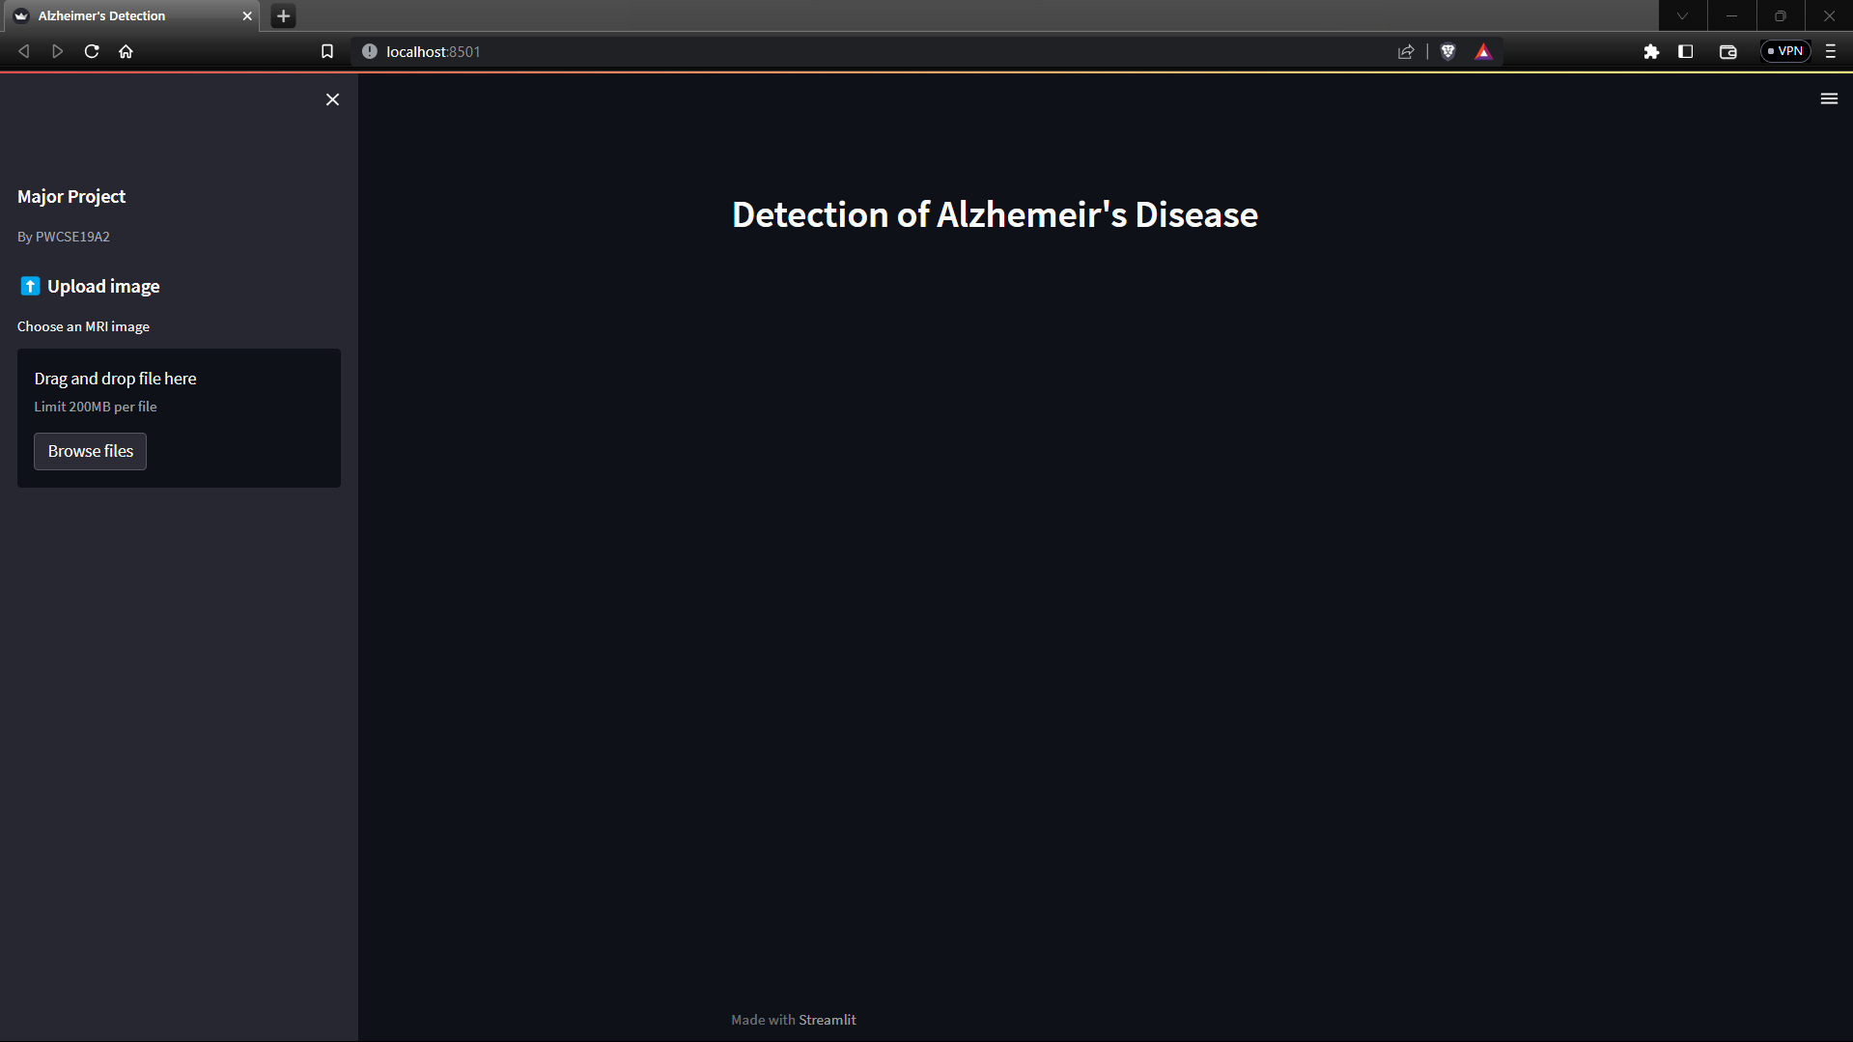

Slide 71
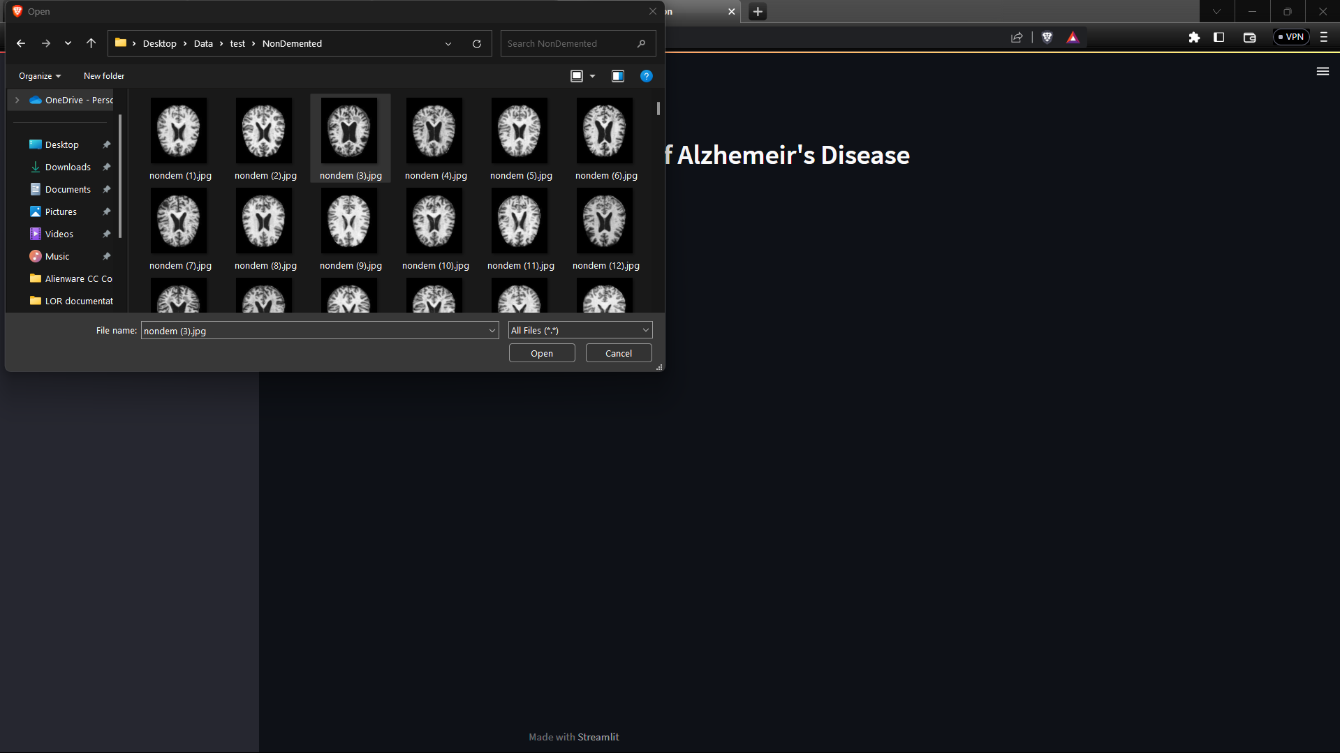

Slide 72
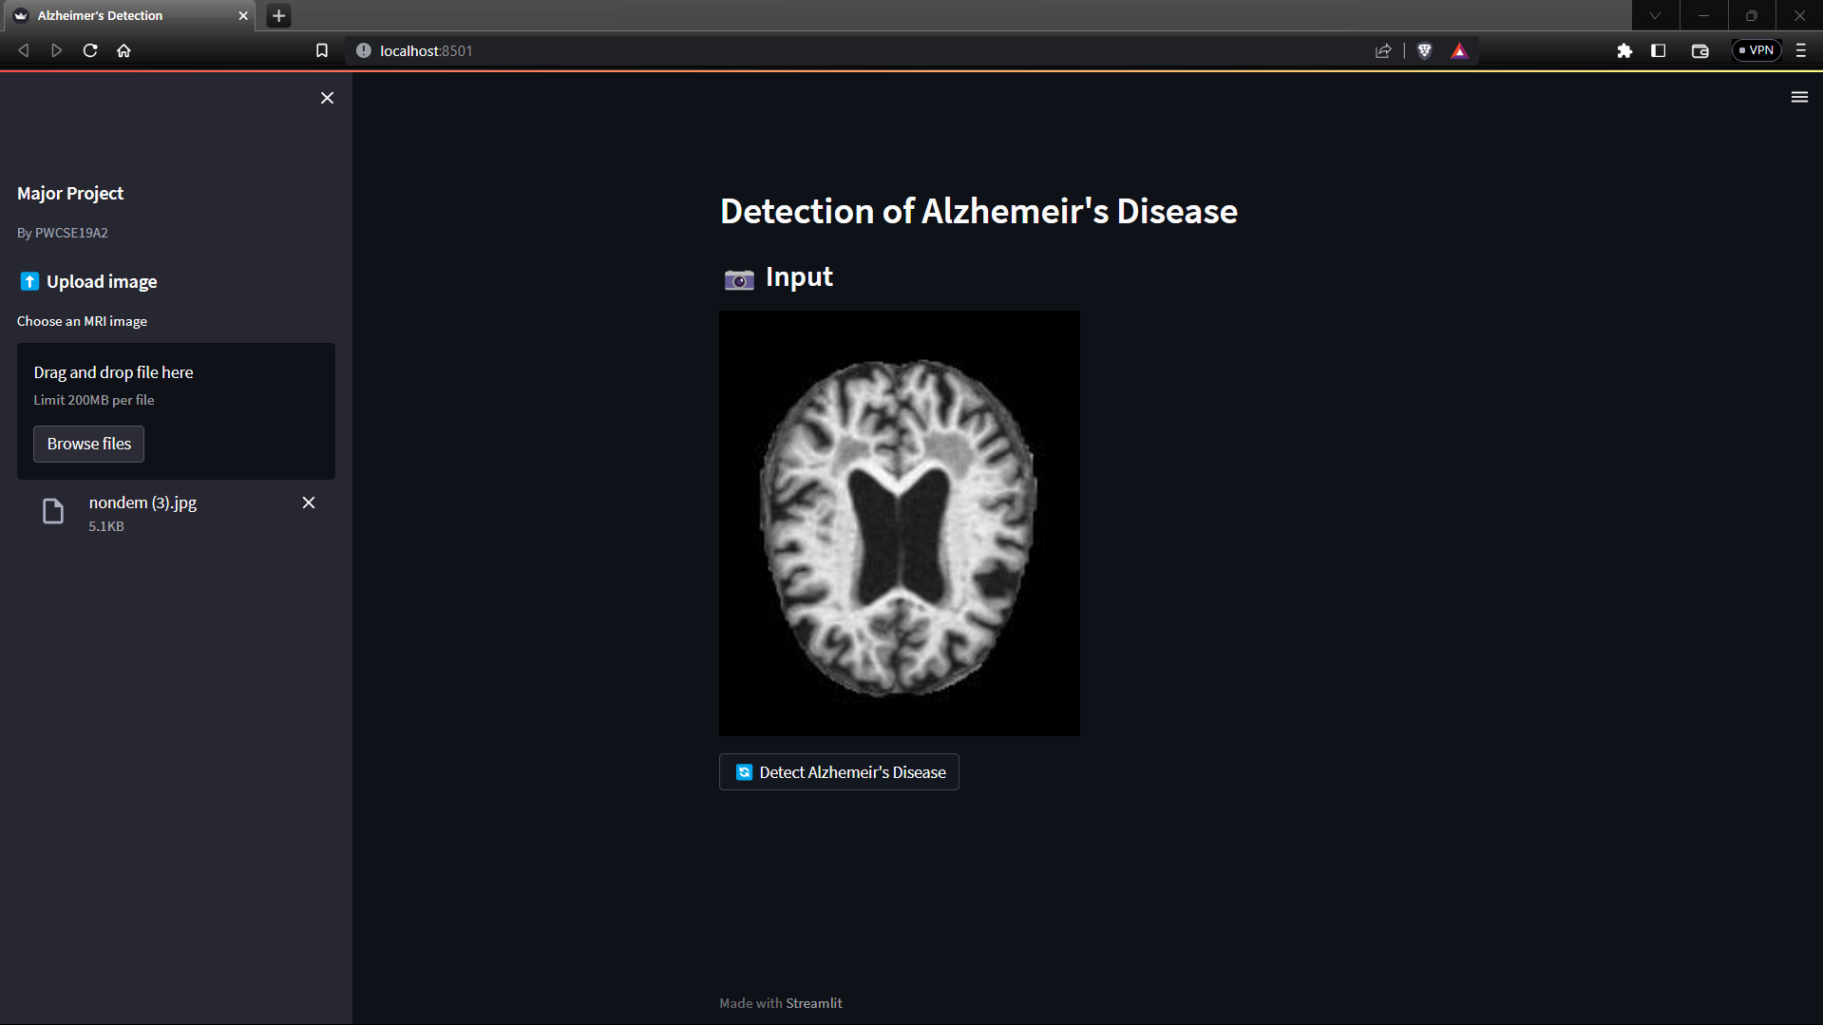

Slide 73
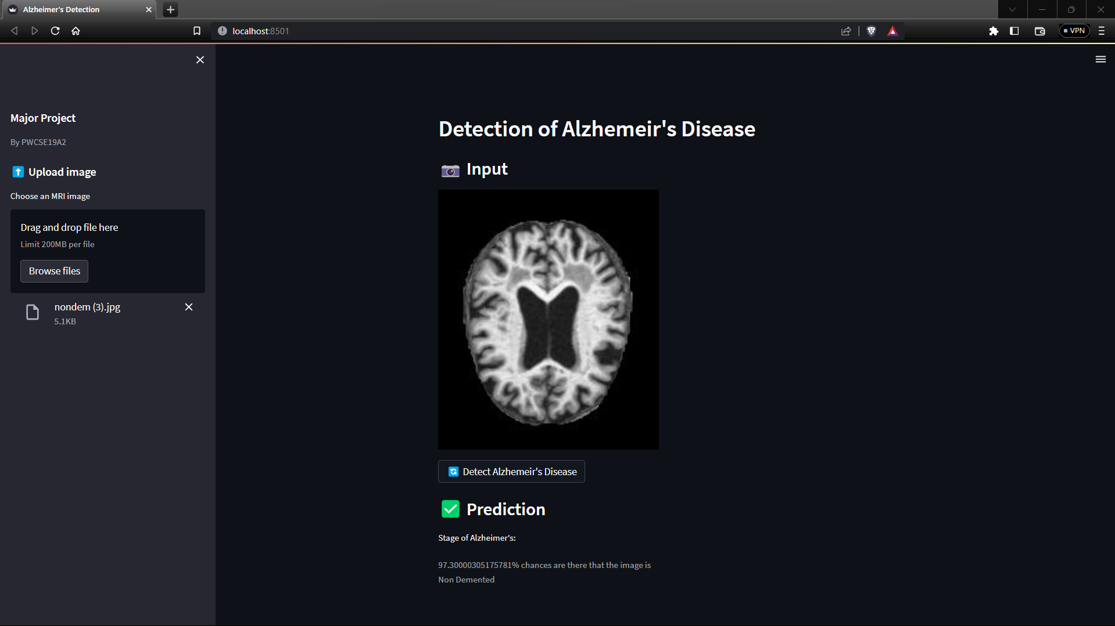

Slide 74
12. CONCLUSION

Slide 75
For Alzheimer’s Disease, It is more important to reduce risk, provide early intervention, and precisely detect symptoms than to deliver a cure. Identifying relevant attributes that can detect Alzheimer's very early remains challenging. A deep learning model could be used to diagnose Alzheimer's stages. Our most comprehensive multi-diagnostic classifiers may be clinically relevant if further prospective RCT-controlled studies are successful.

Slide 76
13. FUTURE SCOPE

Slide 77
Future work will focus on improving the model's accuracy and collecting large amounts of data on Alzheimer's for training the model more efficiently. To improve the detection accuracy of Alzheimer's Disease, it is also important to identify and analyze new features that will help detect the disease, and to remove redundant and irrelevant features from existing feature sets.

Slide 78
Environment used
Development environment : Google Colab Notebook,VScode.
Language : Python 3.11
User Interface : Streamlit

Slide 79
14. BIBLIOGRAPHY

Slide 80
Dan Pan, An Zeng, Longfei Jia,Yin Huang,Tory Frizzell and Xiaowei Song (2020) Early Detection of Alzheimer’s Disease Using Magnetic Resonance Imaging: A Novel Approach Combining Convolutional Neural Networks and Ensemble Learning.
C.Kavitha, Vinodini Mani, S.R Sri Vidhya, Osmah Ibrahim, Carlos Andres (2022) Early-Stage Alzheimer's Disease Prediction Using Machine Learning Models.Early-Stage Alzheimer's Disease Prediction Using Machine Learning Models.
Roobaea Alrobaea, Seifeddine Mechti, Mariem Haoues, Saeed Rubaiee(2021) Alzheimer's Disease Early Detection Using Machine Learning Techniques.

Slide 81
Weiming lin, Tong Tong, Qinquan Gao, Di Guo, Xiaofeng Du, Yonngui Yang, Gang Guo, Min Xiao, Min Du, Xiaobo Qu (2018) Convolutional Neural Networks-Based MRI Image Analysis for the Alzheimer's Disease Prediction From Mild Cognitive Impairment.
Vasco Sá Diogo, Hugo Alexandre Ferreira & Diana Prata (2022) Early diagnosis of Alzheimer’s disease using machine learning: a multi-diagnostic, generalizable approach.
Carol Y cheung, An Ran Ran, Shujun Wang, Victor TT Chan, Kaiser Sham, Saima hilal (2022) A deep learning model for detection of Alzheimer's disease based on retinal photographs: a retrospective, multicentre case-control study.

Slide 82
Taeho jo, Kwangsik Nho, Andrew J.Saykin (2019) Deep Learning in Alzheimer's Disease: Diagnostic Classification and Prognostic Prediction Using Neuroimaging Data.
Muhammed Raees, Vinu Thomas (2021) Automated detection of Alzheimer’s Disease using Deep Learning in MRI.
Sheng Liu, Arjun V. Masukar, Henry Rusinek, Jingyun Chen, Ben Zhang, Weicheng Zhu (2022) Generalizable deep learning model for early Alzheimer’s disease detection from structural MRIs.

Slide 83


